Slide 1
FACE RECOGNITION USING IMAGE PROCESSING.
BATCH- IT-1
K.V.Hemanth -207Z1A1225
Sheldon Shaji -207Z1A1241
V.Nikil -207Z1A1248
Under Guidance :
Mr. T. Madhu

Slide 2

ABSTRACT
The main objective of this project is to recognize the face.
The system subsequently to keep track on the image for further details to identify a face in the image.
It serves as an individual identity of everyone and therefore face recognition helps in authenticating any person's identity using his personal characteristics.
It consists of static where it detects the face and details where it apprehends the occasions that manifest the image.
The most essential goal of project is to recognize the face and provide the details for an image.

Slide 3
REQUIRMENTS
1. SOFTWARE REQUIREMENTS:
• Language: Python
• Technology: OpenCV
• Operating System: Windows 10
2. HARDWARE REQUIREMENTS:
• RAM : 4GB
• Hard Disk: 50GB
• Processor: Dual Core

Slide 4
EXISTING SYSTEM
In the existing system, classification is done through eigenfaces method.
Existing work includes the application of face recognition.
The eigen faces to represent the feature vector for human faces.
It uses eigen vectors and PCA to recognize the faces.
DISADVANTAGES
It recognize only one face at each time.
Time consuming.

Slide 5
PROPOSED SYSTEM
It trains the set of information then it finds in line with them no knowledge loss happens.
Therefore, we can simply acknowledge the feel and classification done by Neural Networks.
In addition to that, recognize the image and provide the name for the image in the rectangular box.
ADVANTAGES
It recognize multiple faces in an image at once.
Fast and easy implementation.

Slide 6
PROJECT MODULES
Image capture
Image processing
Face recognition

Slide 7
IMAGE CAPTURE
Resolution
Position of the face need not to be fixed
Can wear spectacles.

Slide 8
IMAGE PROCESSING
Understanding how does the system looks at the image
Converting colour image to grayscale image
Converting grayscale image to black and white image

Slide 9
FACE RECOGNITION
Neural networks are designed to work just like the human brain.
An Artificial Neural Networks is made up of 3 components:
Input Layer
Hidden (computation) Layers
Output Layer.

Slide 10
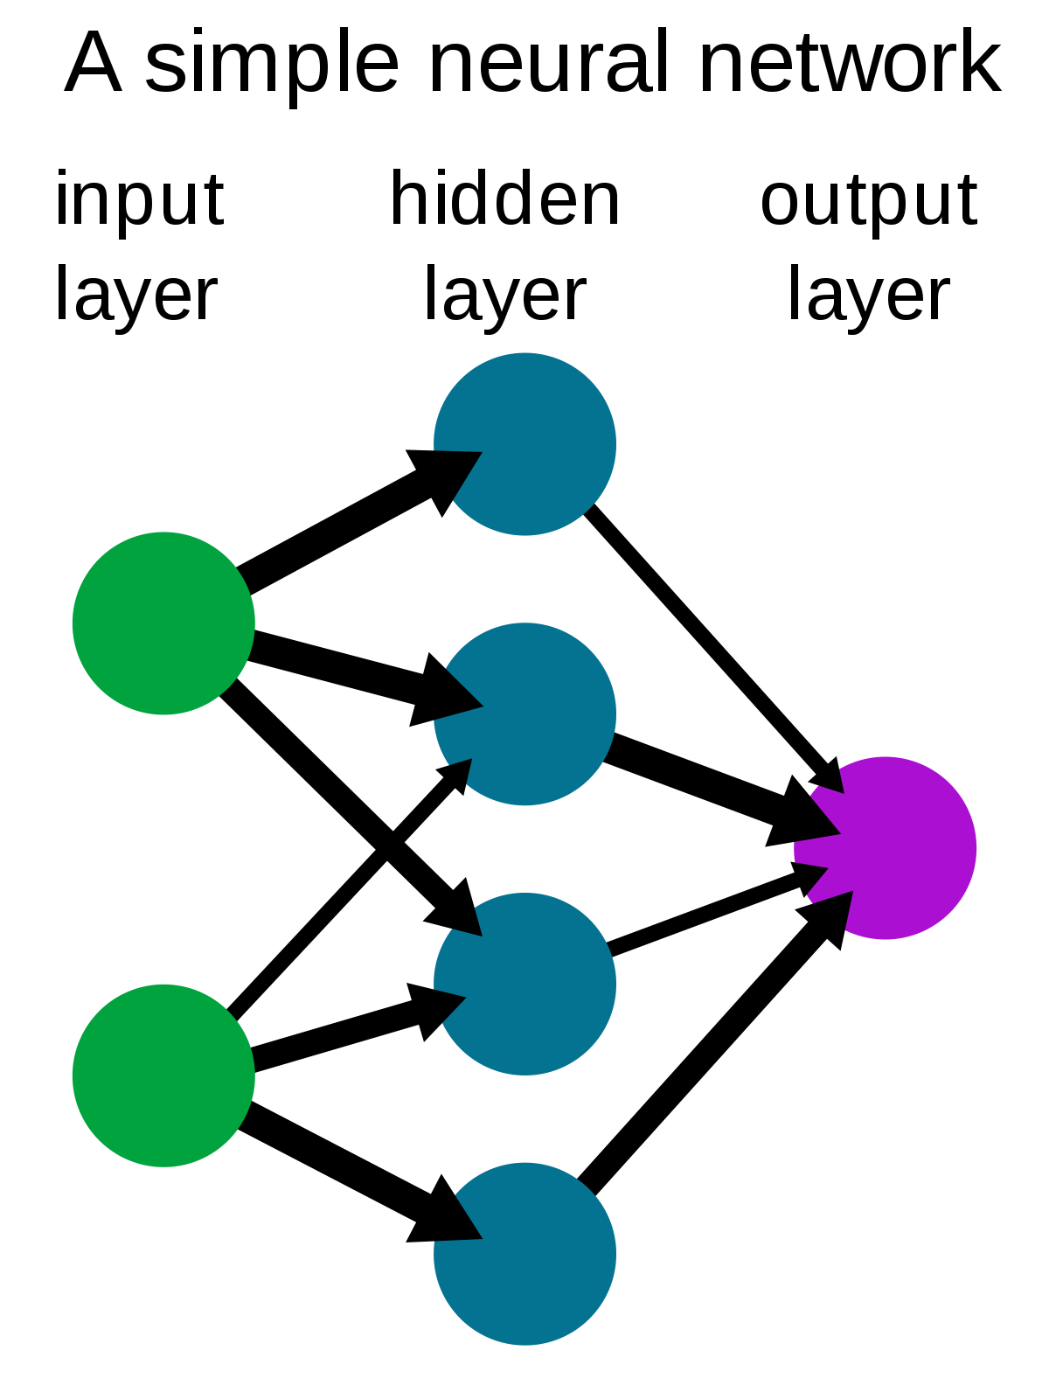

Slide 11
HAAR CASCADE
Haar Cascade is a machine learning-based approach where a lot of positive and negative images are used to train the classifier.
POSITIVE IMAGES – These images contain the images which we want our classifier to identify.
NEGATIVE IMAGES – Images of everything else, which do not contain the object we want to detect.

Slide 12
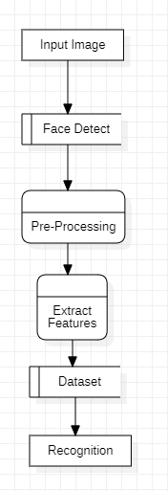
Data Flow Diagram

Slide 13
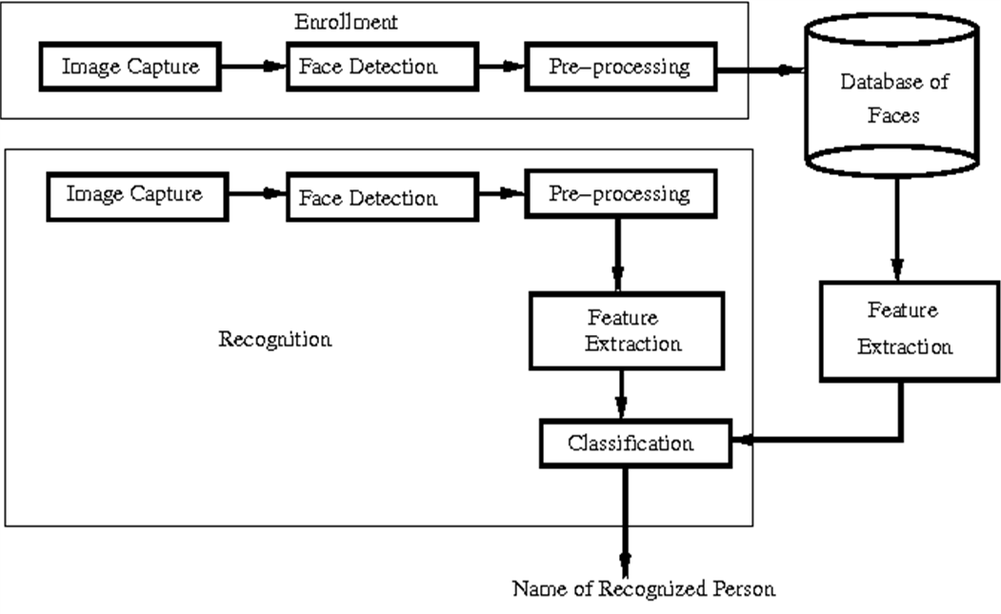
Architecture
Pre-Processing
Feature Extraction
Face Detect

Slide 14
UML DIAGRAMS
IMAGE
Use Case Diagram
PREPROCESSING
FEATURE EXTRACTION
FACE DETECT
USER
CLASSIFICATION
<<include>>
TEST IMAGE
RECOGNITION

Slide 15
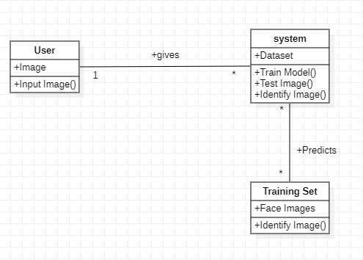
Class Diagram

Slide 16
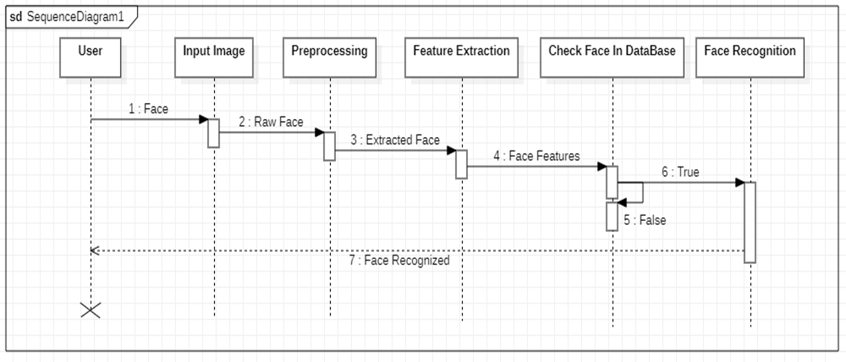
Sequence Diagram

Slide 17
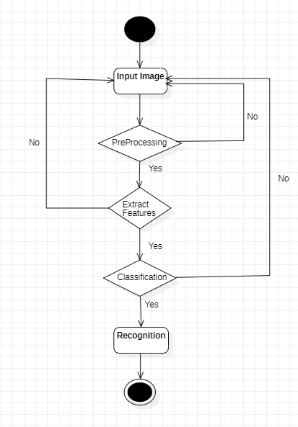
Activity Diagram

Slide 18
Implementation
Steps to Implement
Step-1 : Installing all the Packages Required.
Step-2 : Write the code in respective IDE.
Step-3 : Debug and Run the code.
Step-4 : The Output will be Displayed.

Slide 19
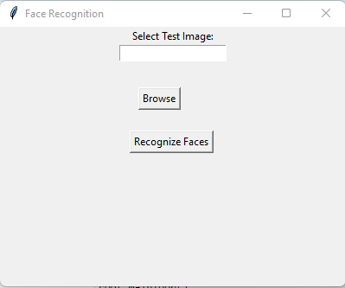

Output Screens

Slide 20
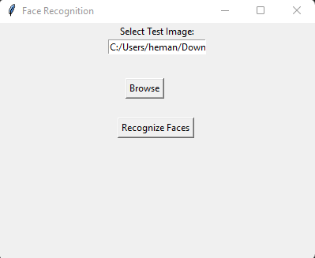

Slide 21
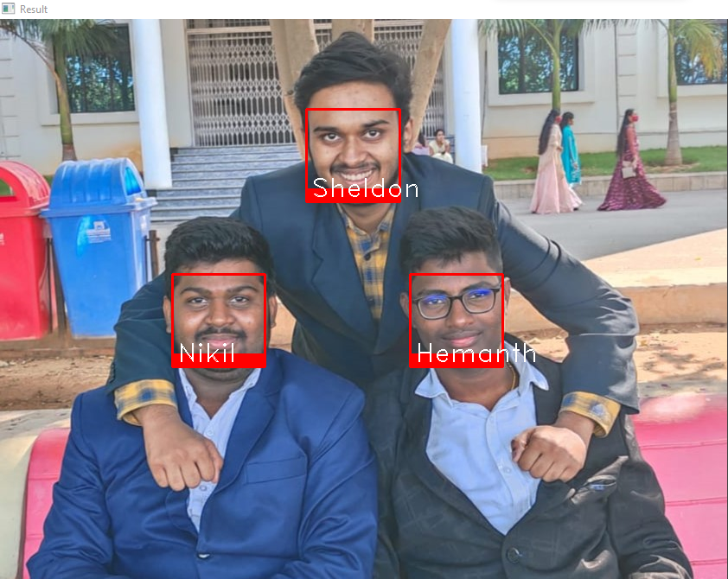

Slide 22
Test Cases
TEST CASE ID | TEST CASE DESCRIPTION | INPUTS | EXPECTED OUTPUT | ACTUAL OUTPUT | STATUS
1 | Train the Data | Import the images as we required. | Need to Train the data. | Reading data is done. | Success
2 | Train the Data | Importing the Blur Images. | It can’t be trained. | Images are not trained. | Success
3 | Detect facial features | Face bounding box region | Need to extract eye , mouth, nose contours | Feature extraction is done. | Success
4 | Browse Button | We need to provide the Test Image | Select the Image and click Enter. | Image will be Uploaded. | Success
5 | GUI | It will open a GUI application. | Window will be open. | Window Displayed. | Success

Slide 23
TEST CASE ID | TEST CASE DESCRIPTION | INPUTS | EXPECTED OUTPUT | ACTUAL OUTPUT | STATUS
6 | Test Image | We need to provide the Test Image Conditions. | The recognition of the image is done Successful. | The Image is Recognized. | Success
7 | Face recognition | Image depicting a face. | Face is recognized | Face is properly recognized | Success
8 | Compare the database | Face features are checked in database | Compared the face in database | Face compared successfully | Success
9 | Output Screen | The output of Test Image will be displayed. | Users face should be recognized. | User face is Recognized. | Success

Slide 24
FUTURE ENCHANCEMENT
Future Enhancement is recognizing the faces in the video Surveillance.
Also providing the security in Banking and in Patient Identification in Health
care.
In Law Enforcement like Criminal Identification ,Missing Persons.

Slide 25
CONCLUSION
It can be used to solve intriguing tasks such as face recognizing, although this task was quite convolute even more when using a large image.
We humans also sometimes make a mistake while recognizing someone’s faces so is our program.
In Present Work, we recognized different types of human faces using Python, OpenCV & Database and got some interesting insight about it.

Slide 26
REFERENCES
https://ieeexplore.ieee.org
https://www.studyglance.in
https://stackoverflow.com/

Slide 27
THANK YOU

